Slide 1
Loan Default Prediction
AKASH MATHUR

Slide 2
Summary of Modeling approach
Below are the key findings and insights gained from this exercise:
Problem: We have to predict the likelihood of a borrower defaulting on a loan using a machine learning model based on variety of factors given. This is an imbalanced dataset, hence the ML approach taken here is to build a robust model which is fully compatible with imbalanced dataset.
Approach: When dealing with imbalanced data, such as our loan default classification task with a majority of "not default" instances, I have used ensemble methods like gradient boosting algorithms - LightGBM and XGBoost which are robust to imbalance datasets. We have used another technique like Synthetic Minority Over-sampling Technique (SMOTE) to generate synthetic examples of the minority class and compared the results at the end.
Evaluation Metric: Accuracy is not an appropriate metric for imbalanced data. Instead, we have consider metrics as F1-score, and area under the ROC curve (AUC-ROC) that provide a more comprehensive evaluation of model performance on both classes.
Limitations and future directions: Due to time constraint on weekdays, the algorithms were not fine tuned to an extent they can be. I have tried to explore 3 algorithms and compared the results. As a potential future enhancements, these models can be fine-tuned further by employing further feature engineering and hyper parameter optimization techniques. They can also be trained for longer EVALS and more Stratified Cross validation splits. Also, incorporating additional public/private data sources, exploring alternative algorithms, or refining the existing models will be a good idea.
Conclusion: LightGBM model worked well as compared to XGBoost and SMOTE in terms of training time and AUC-ROC score.

Slide 3
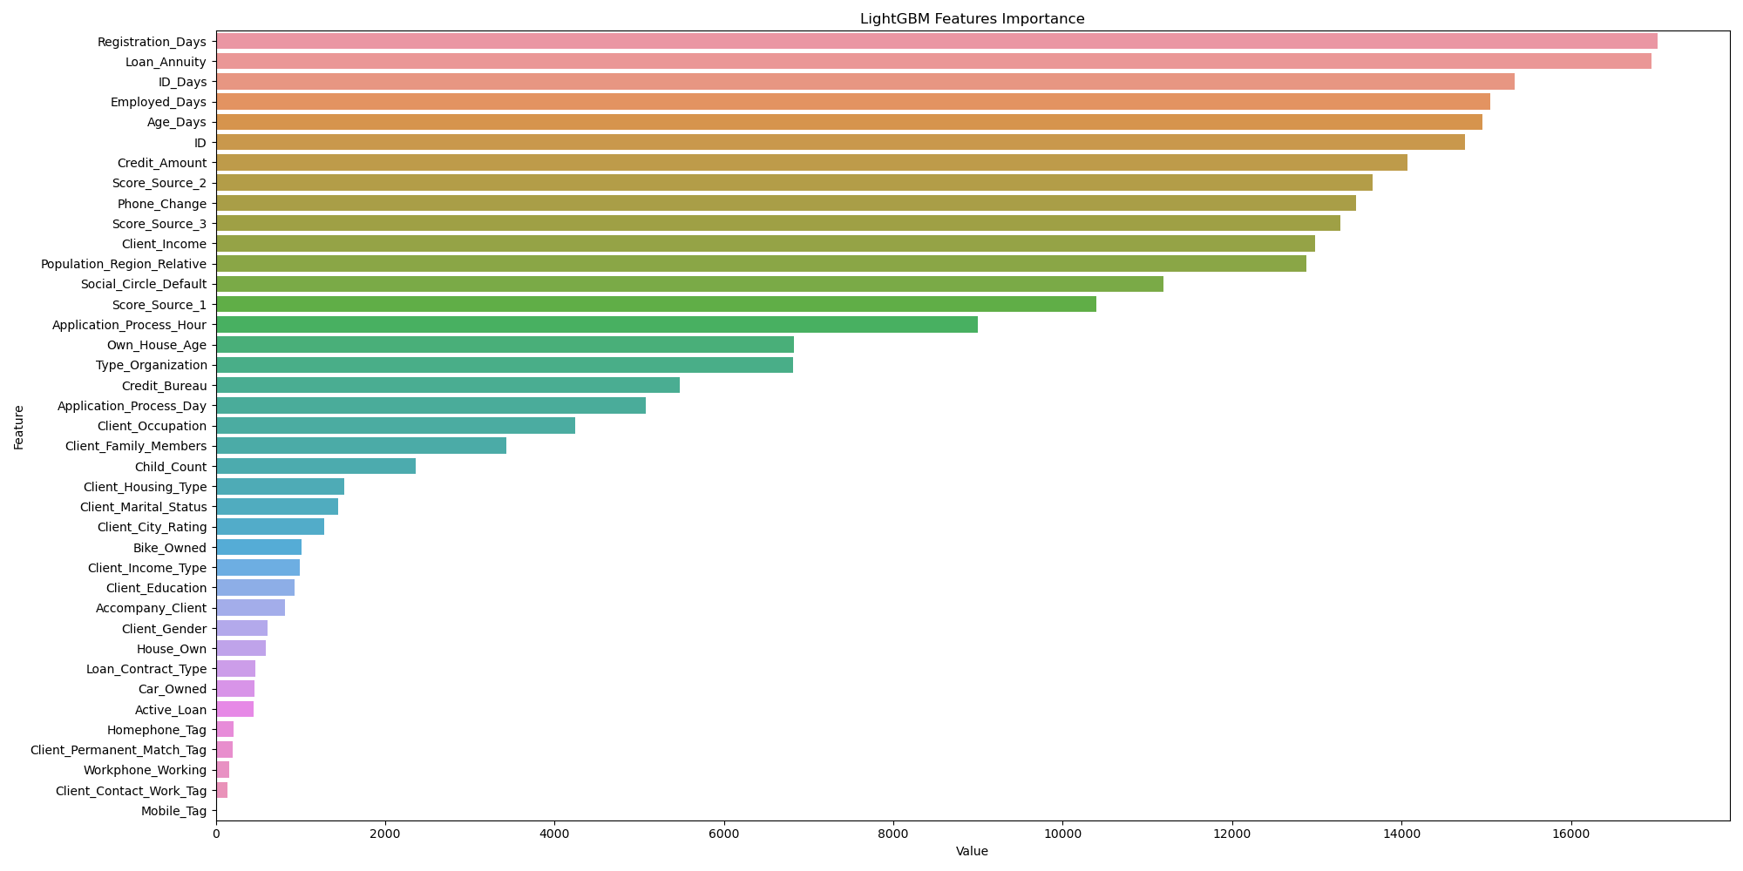
Light gbm feature importance graph

Slide 4
Design system architecture to deploy ML Model in production
Below are the steps to deploy this model into production -
Data Acquisition
Data Validation(Sanity check for all data sources)
Data Cleaning and Transformation
Feature Engineering
Model Training : Try multiple algorithms, and compare results based on results accuracy, model development time and prediction speed. Leverage automated Hyper-Parameter Optimisation using HyperOpt Bayesian Optimization which is faster and gives better results than traditional search methods.
Model Validation/Evaluation : Feature Selection using the Feature importance , Use Shap to draw Summary plot, Partial Dependence plot and Permutation Importance graph.
AWS Infrastructure
Build a serverless workflow on AWS which will read data from S3, pre-process the data, trained the model and will do prediction, and write back the results to ATHENA using below services.
AWS Lambda Function– It will be triggered by a S3 PUT event, as soon as all the input files are uploaded on the S3 folder, it will trigger the Step Function
The Step function has 3 AWS ECS tasks, each task would be a Python application packaged as Docker Image and pushed to ECR
--- AWS ECS Task (AWS ECS Fargate) – Reading Data, Pre-processing & Transformation, Feature engineering
--- AWS ECS Task –Model Training (If we are not training our model frequently, then it’s recommended to store the model on S3, and load directly in the next prediction step.
--- AWS ECS Task –Model Prediction and Save output as Athena Table.

Slide 5
Design framework for continuous delivery and automation of machine learning tasks
Below is the framework for continuous integration and delivery of machine learning (ML) models:
Version Control: Use a version control system (e.g., Git) to manage ML code, models, and configurations. Maintain separate branches for development, testing, and production code.
Continuous Integration (CI): Set up a CI server (e.g. GitLab CI) to automate the build and testing process. Trigger automated builds and tests whenever changes are pushed to the version control system.
Automated Testing: Automated testing to validate ML models and associated components. Include unit tests, and integration tests. Integrate testing frameworks (e.g., pytest, Sonarqube) into the CI pipeline.
Model Training and Evaluation: Define a pipeline for automated model training and evaluation. And automatically track and log model performance metrics.
Model Deployment: Utilize Docker containerization to package ML models and dependencies to ensure consistency and reproducibility.
Continuous Deployment (CD): Build a CD pipeline to automate the deployment of ML models to production. Implement continuous deployment triggers based on successful testing and evaluation. Deploy ML models as services or APIs for inference.
Continuous Monitoring and Optimization: Implement monitoring systems to track model performance, data/concept drift, and system health. Set up alerts and notifications for anomalies or degradation in model performance. Gather stakeholders feedback to iterate and improve models over time.
Infrastructure as Code (IaC): Utilize infrastructure provisioning tools (e.g., Terraform) to automate infrastructure setup.

Slide 6
How do you perform canary build?
Below is the framework to perform canary build:
Identify Canary Group: Select a subset of users, often referred to as a canary group, who will be exposed to the new version of the application. This group should be representative of the broader user base.
Deploy the New Version: Deploy the updated version of the application or service to the canary group only.
Monitor and Collect Metrics: Monitor the performance, behavior, and metrics of the canary deployment. This includes monitoring system metrics, application logs, user feedback, and any defined KPI. Compare these metrics against a baseline or the existing stable version.
Testing and Validation: Conduct thorough testing of the canary deployment. This includes functional testing, performance testing, and any specific tests relevant to the changes introduced. Validate that the new version meets the desired criteria and doesn't introduce any critical issues.
Partial Rollout: Based on the monitoring and validation results, partially increase the exposure of the new version to a larger audience. This can involve gradually expanding the canary group or routing a percentage of traffic to the new version while monitoring for any anomalies or issues.
Rollback or Full Deployment: Based on the feedback, metrics, and stability of the canary deployment, make a decision to either roll back the changes if significant issues are encountered or proceed with a full deployment to the entire user base or infrastructure.
Communication and Feedback: Communicate the canary deployment process to stakeholders and gather feedback from the canary group and users. Incorporate feedback and make necessary adjustments before proceeding with a wider rollout.

Slide 7
What should be the strategy for ML Model Monitoring?
Here are some key strategies for ML model monitoring:
Define Monitoring Objectives: Define the monitoring objectives based on the requirements of the ML model. This could include tracking precision, recall, ROC-AUC or other relevant metrics. Establish thresholds or benchmarks to determine acceptable performance levels.
Data Quality Monitoring: Monitor the quality of input data to identify anomalies, missing values, or data drift. Track statistical measures, such as data distribution, feature correlation, and missing data patterns. Implement data validation and alert mechanisms when data quality issues are detected.
Model Performance Monitoring: Continuously monitor the performance of your ML model on real-world data based on key metrics. Compare model performance against baseline or expected performance. Set up alerts for significant drops or deviations from expected performance.
Drift Detection: Monitor data drift and concept drift to ensure that the model's performance remains consistent over time. Detect shifts in input data distribution or changes in the relationships between features and target variables. Set up automated mechanisms to alert when drift is detected.
Error Analysis: Analyze misclassified instances, false positives, false negatives, or other relevant errors.
Model Explainability and Interpretability: Implement techniques for model explainability to understand how and why the model makes predictions. We can use feature importance analysis, and SHAP values.
Continuous Feedback Loop: Establish a feedback loop with stakeholders, domain experts, and end-users to gather insights and feedback on model performance and usability.
Documentation: Maintain comprehensive documentation of the monitoring process, findings, and actions taken. Generate regular reports summarizing the performance, issues, and improvements made to the ML model.

Slide 8
How do you perform load and stress tesTIng?
Here's an overview of how to perform load and stress testing:
Define Test Scenarios: Identify the different scenarios that our system may encounter in real-world situations. Determine the types of requests, user interactions, or operations that need to be simulated during the testing.
Set Performance Goals: Establish specific performance goals and metrics to measure during the testing. This could include response time, throughput, concurrent users, resource utilization, or any other relevant metrics based on our system requirements.
Design Test Cases: Create a set of test cases that represent realistic usage scenarios. Define the workload, user behavior, and data inputs for each test case.
Select Load Testing Tools: Choose a suitable load testing tool or framework that fits your requirements.
Configure Test Environment: Set up a test environment that closely resembles your production environment.
Execute Load Tests: Run the load tests by simulating multiple users or concurrent requests based on the defined test cases. Gradually increase the load to reach the desired stress levels. Monitor and measure the system's performance metrics during the tests.
Analyze Results: Collect and analyze the performance metrics captured during the load tests. Assess the system's response times, throughput, error rates, resource utilization, and other relevant data. Identify any bottlenecks, performance degradation, or areas of improvement.
Performance Optimization: Based on the analysis, identify areas for performance optimization. This may involve tuning server configurations, optimizing database queries, improving caching mechanisms, or revising application code. Iteratively retest and validate the optimizations to ensure improvements.
Stress Testing: Once load testing is completed, perform stress testing to determine the system's breaking point and its behavior under extreme load conditions. Gradually increase the load until the system reaches its limit. Observe how the system handles the stress, recovers, and assess any critical failures.
Reporting and Documentation: Document the load and stress testing process, test results, observations, and any recommendations for improvement. Generate comprehensive reports that summarize the performance metrics, issues encountered, and the actions taken or planned.

Slide 9
How do you track, monitor and audit ML training?
Here's how we can effectively track, monitor, and audit ML training:
Version Control: Utilize a version control system (e.g., Git) to track changes in ML code, scripts, and configurations. Maintain separate branches for different experiments and iterations.
Experiment Tracking: Use ML experiment tracking tools (e.g., MLflow) to record and log experiment details. Track hyperparameters, datasets used, model architectures, and other relevant information for each experiment. Capture metrics, losses, and evaluation results.
Data Logging: Log data preprocessing steps, transformations, and feature engineering techniques applied to input data.
Model Architecture and Configuration: Maintain a record of the model architecture, network structure, layers, and parameters. Document the optimizer, learning rate, regularization techniques, and any other configuration details used during training.
Parameters: Record the training parameters such as batch size, number of epochs, and early stopping criteria. Monitor the training progress by logging intermediate metrics, loss values, and validation scores at regular intervals.
Checkpoints: Save checkpoints or snapshots of the model at different stages of training. This allows you to track the model's progress and compare performance between different checkpoints.
Logging and Monitoring: Implement logging mechanisms to capture system-level logs, error messages, warnings, and debugging information during training.
Model Evaluation and Validation: Document the evaluation metrics used to assess the model's performance, such as ROC-AUC, precision, recall, and F1 score. Monitor and track validation scores across different iterations and experiments.
Reproducibility: Maintain a record of the software dependencies, libraries, and versions used during training. Use package managers (e.g., pip, conda) or containerization (e.g., Docker) to ensure consistent environments for training and reproduction of results.
Documentation: Maintain comprehensive documentation of the ML training process, including experimental setups, data sources, pre-processing steps, model configurations, and evaluation results.

Slide 10
END

